Slide 1
Supersonic Spelling Stars

Slide 2
Why?
At Bailey’s Court we strive to improve the children’s spelling but also develop their language and this programme does both. Supersonic Phonic Friends was rolled out last year and has had a huge impact on the children’s knowledge of phonics.

Slide 3
What is Supersonic Spelling Stars?
Scheme based on spelling rules and common exception words for Key Stage 2
A two week spelling programme – week 1 ‘Word Whizz’ and week 2 ‘Spelling Star’
At Bailey’s Court the children will have 3 spelling lessons a week plus one test

Slide 4
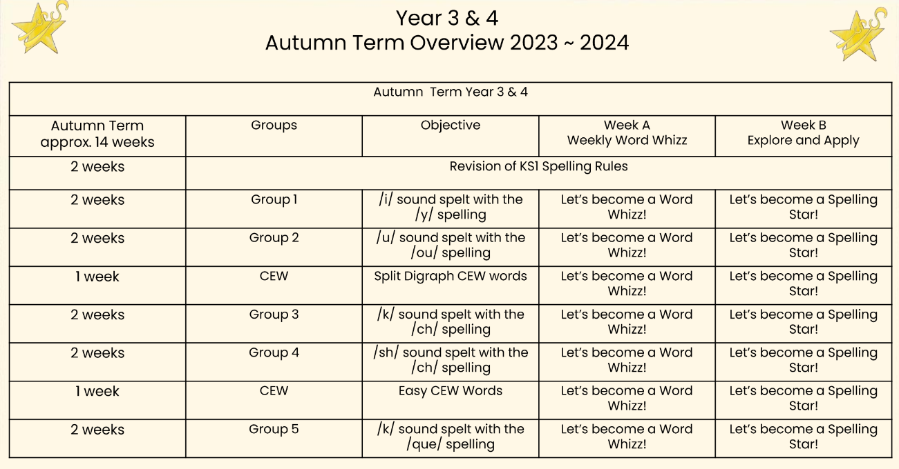
Year 3/4 planning overview for Term 1 and 2

Slide 5
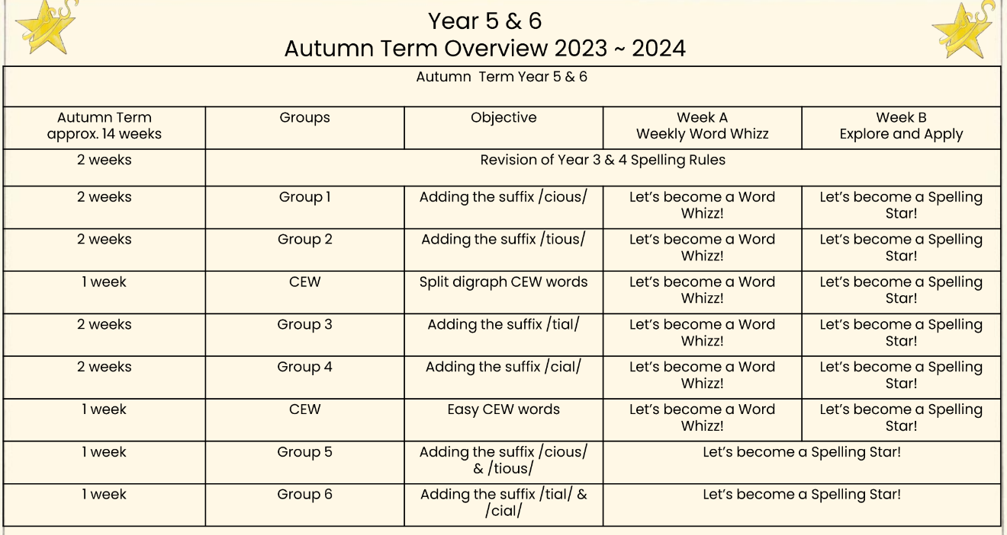
Year 5/6 planning overview for Term 1 and 2

Slide 6
The lessons
Week 1: Word Whizz
Week 2: Spelling Stars
Let’s have a look at some lessons

Slide 7
Word Whizz
Year 3/4 Spellings
‘i’ sound spelt with the ‘y’ spelling

Slide 8
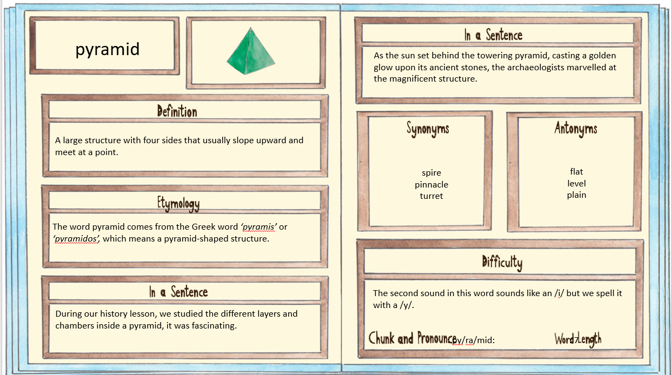
Word Whizz
Example word

Slide 9
Spelling Stars
Example of introducing the spelling objective/rule.

Slide 10
Spelling Stars
Example reading activity

Slide 11
Spelling Stars
Example writing activity

Slide 12
Spelling Stars
Pupils might do a mighty mission in Springboard or with a teaching assistant.

Slide 13
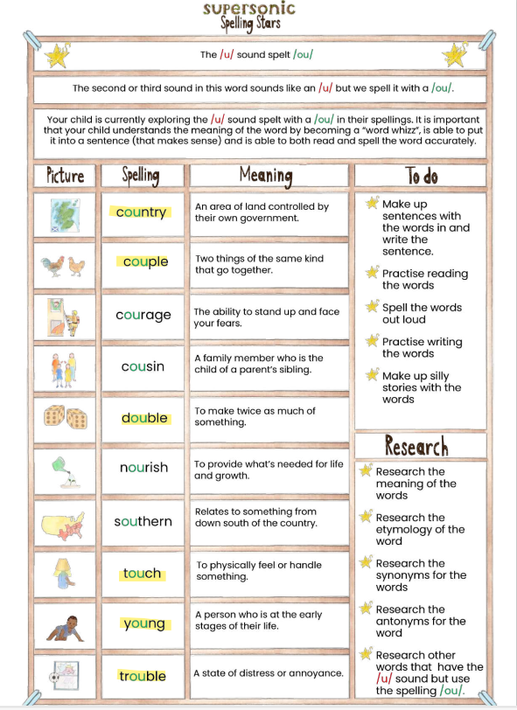
Spelling tests and spelling handout
The children should now have a spelling folder which needs to be brought in each week on their spelling day.
The children will get a new sheet each week.
Week 1: Word Whizz – the children to match the word to the definition
Week 2: Spelling Test – a ‘normal’ spelling test like we have been doing

Slide 14
Spelling test days
Year 3 | Thursday
Year 4 | Wednesday
Year 5 | Friday

Slide 15
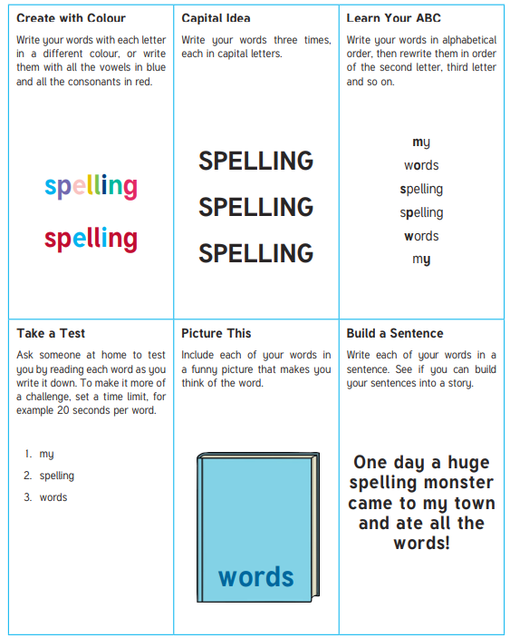
How to support your child learning their spellings

