Slide 1
Year 6 camp 9th – 13th September 2024

Slide 2
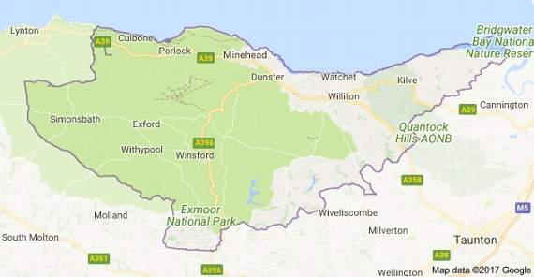

Slide 3
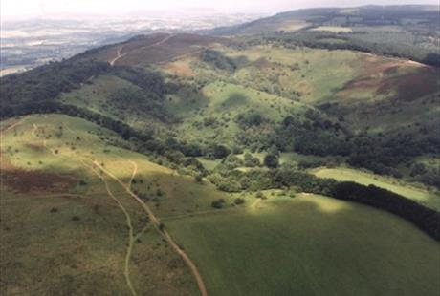
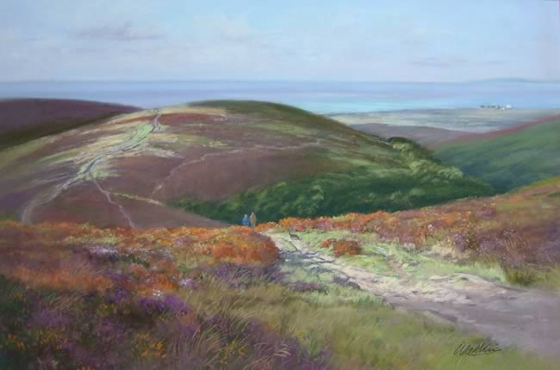

Slide 4
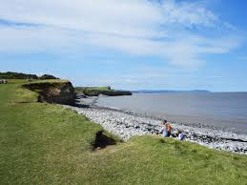

Slide 5
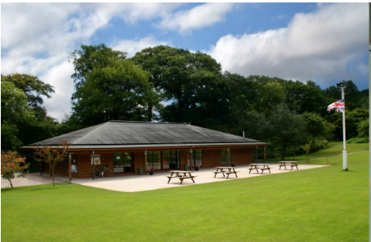

Slide 6
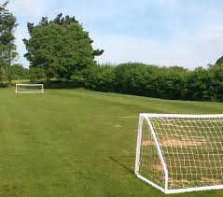

Slide 7
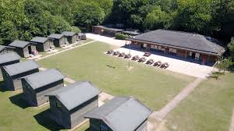

Slide 8
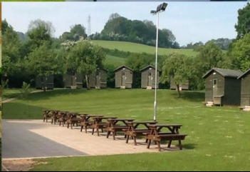

Slide 9
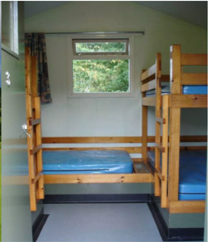

Slide 10
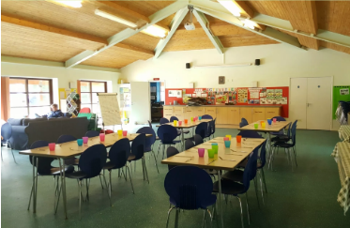

Slide 11
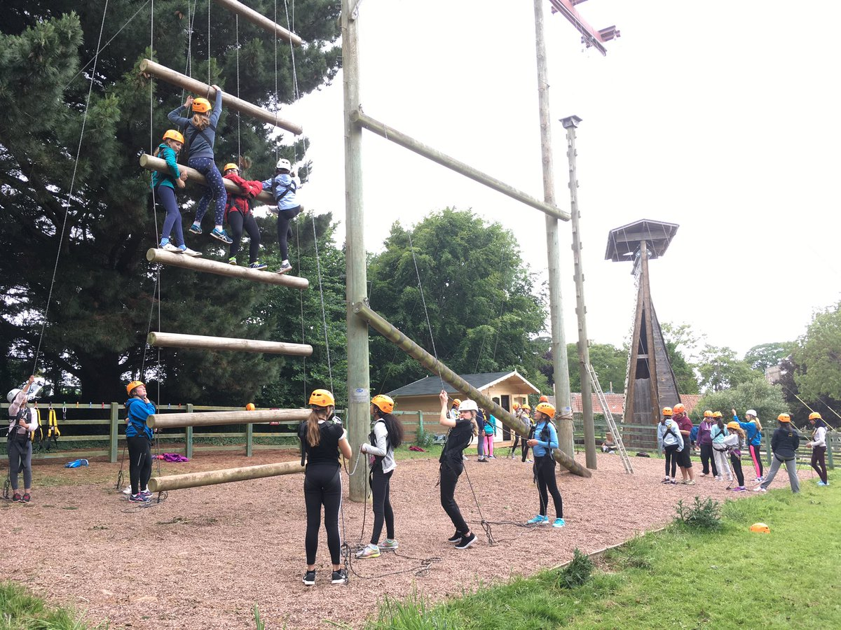

Slide 12
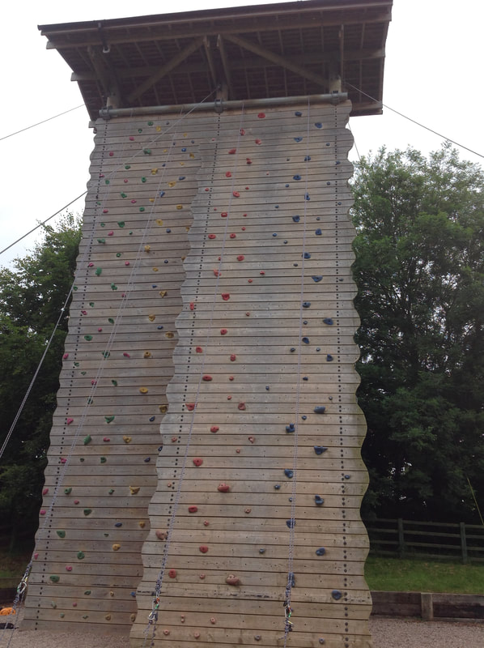

Slide 16
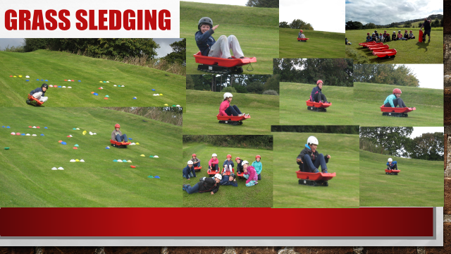

Slide 18
Medication / Dietary Requirements
We will be sending you a form in Term 6 asking for information regarding your child (medical conditions / doctor’s surgery / dietary needs etc)
If your child takes specific medication you will be required to sign a “Request to administer medication” form
The centre will cater for all dietary needs (vegetarian / vegan / allergies etc)

Slide 19
Room Allocations
Children will be able to say who they would like to share a room with
A lot of time will spent by the teachers ensuring that every child has at least one of their friends in their room
Separate boys / girls rooms
Teacher’s rooms will be interspersed between children’s rooms – children will know where to go in case of an emergency

Slide 20
Kit List for Activity Courses
Please note that all students are required to bring their own sleeping bag (or duvet), a single fitted sheet (or a flat sheet) and a pillow case.
There is a small shop that sells postcards and gifts. It is suggested that a maximum of £5.00 per child be brought to spend there.
Students are requested not to bring mobile phones or electronic devices.
Please bring your own lunches to eat on arrival unless otherwise agreed.
Kit List
Outdoor shoes/trainers
Wellington boots
Trousers/track suits (not jeans)
Sweatshirt/fleece/warm jumper
Waterproof coat – over trousers if possible but not essential
T-shirts (that cover stomach and shoulders) and shorts (warm weather)
Sun hat and sun cream (warm weather)
Night wear
Toilet bag – soap, flannel, toothbrush, toothpaste etc.
Towel
Water bottle

Slide 21
Special Requirements for Certain Activities
Archery – Long sleeved top, not baggy
Stream Walk – Very old clothes, very old trainers or Wellington boots
Abseil, high ropes and climbing – tops that cover your stomach and shoulders and hair tied back.
Useful Extras
Torch
Small rucksack
Camera (disposable is best and named)
Book
ALL KIT MUST BE CLEARLY NAMED

Slide 22
Cost
Approximately £365 per pupil plus transport costs (approx. £15-20 per pupil – we are not able to get precise quotes at the moment). The exact price will be confirmed in January when a letter will be sent out detailing prices, deposits, payment schedules, etc.
Price is comparable with what other schools pay
Cost is calculated on the basis of all children attending (so could possibly be more if fewer children attend)
If your child is classed as Pupil Premium, please contact the school office

Slide 23
In summary, Year 6 camp:
helps children to develop confidence and independence
gives them an opportunity to try out new experiences and to expand their world
is great fun (and will be remembered for years to come)
helps them to build relationships with their peers and their teachers – important as they enter the challenges of Year 6
prepares them for other challenges/opportunities which they will face when they enter secondary school
gives you a week off!

